Slide 1

#Littlewins

Slide 2



Meeting Title
10/12/2018

Slide 3
Welcome, new hire!
Name
Software Engineer
More to come.

Slide 4


GIT FROZEN UNTIL version
Exceptions -> master

Slide 5

Goals

Slide 6
2018:
Two months left!

Slide 7
2019:
Coming soon

Slide 8
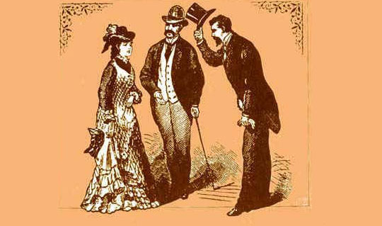
Remote Etiquette Guidelines
AUDIO: CHECK IT
VIDEO: USE IT

Slide 9
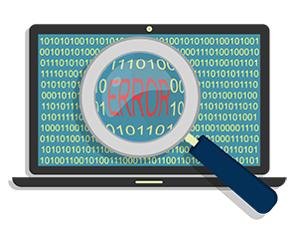
Quick Note On Testing…

Slide 10
ANYONE
CAN DO IT.
BUT Teams own their PROCESS.
Notes:
No restrictions

Slide 11

Do Quality Engineers need to perform some level of testing on any given ticket?
NO.

Slide 12

But what if I don’t want to test?
Notes:
We’re in the business of getting work done

Slide 13
Process Pro Tips
{
}
USE METRICS
Experiment
Fail fast
REPEAT

Slide 14
One more thing…

